Slide 1
Predicting Greatest Cricketer by Comparing Different Machine Learning Approaches
Name: Nadeem Theba
Student ID: 20029831
Supervisor: Dr. Fouad Shat

Slide 2

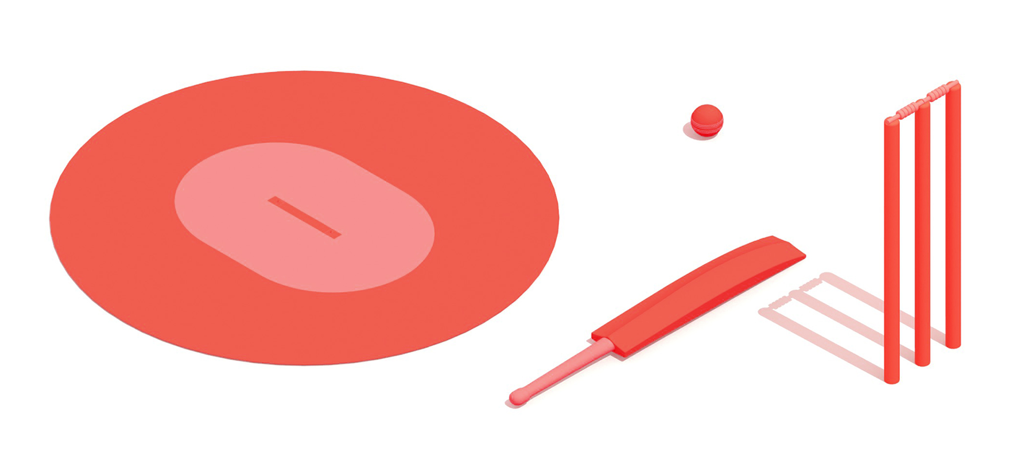
Project Objective
The purpose of this research is to provide a simple and uncomplicated strategy for discovering different important performance variables that link to a cricketer's high performance.
This project addresses the research question, "Which characteristics contribute to predicting the next great cricketer?"

Slide 3


Methodology
Implemented using Python 3.9.0 and Anaconda 4.8.5
1
Defining Performance Metrics
Principal component analysis is used in this study to evaluate and rate the performance of both bowlers and batters. Higher scores for both PCA batsmen and PCA bowlers reflect a player's superior performance.
Batting Average (BA)
Strike Rate (SR)
Total Runs scored (TR)
Number of Hundreds
Number of Fifties
Number of Sixes
Number of Fours
PCA_batsmen=(0.458*TR)+(0.398*BA)+(0.325*SR)+ (0.406*Fours)+(0.417*Sixes)+0.432*sum(Hundreds+Fifties)
PCA_bowler=-(0.428*-WT)+(0.591*-BA)+(0.383*-ER)+(0.566*-SR)
Wickets Taken (WT)
Economy Rate (ER)
Bowling Average (BA)
Strike Rate (SR)

Slide 4
Methodology
Implemented using Python 3.9.0 and Anaconda 4.8.5
2
Dataset Preparation
Data Collection: The data used in this study is obtained from a verified source for cricket data: www.espncricinfo.com.
For this study, two distinct datasets (batsmen and bowlers) consisting of players' career-long performance are investigated, including as many as 27,988 cricket batsmen and 2,200 cricket bowlers.
Data Cleaning: Following steps has been performed to conduct data cleaning of both the datasets,
Removal of null values
Removal of special characters from columns
Removal of unnecessary columns (which do not contribute to the performance metrics)
Lowercase of data values
Datatype conversion wherever required
Added additional columns ‘100Sum50’, ‘PCA_batsmen’, and ‘PCA_bowler’
Performing label encoding to ‘Player’ column
After data cleaning, the batsmen data contains 2554 rows and the bowler's data contains1742 rows and 13 columns.

Slide 5
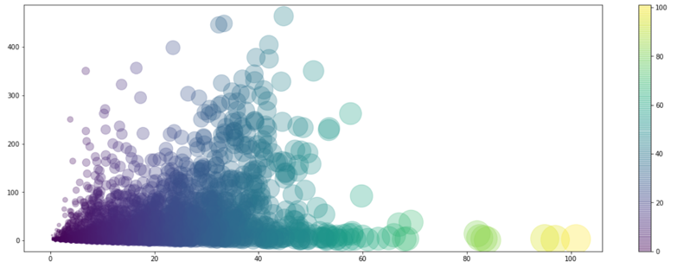
Methodology
Implemented using Python 3.9.0 and Anaconda 4.8.5 and libraries such as Matplotlib and Seaborn for visualization
3
Exploratory Data Analysis
The goal of exploratory data analysis is to investigate various aspects of cricket and identify the best performers in terms of batting and bowling.
The following visualization helps answer the question, “Does the number of matches a batsman plays influence his batting average? ”

Slide 6
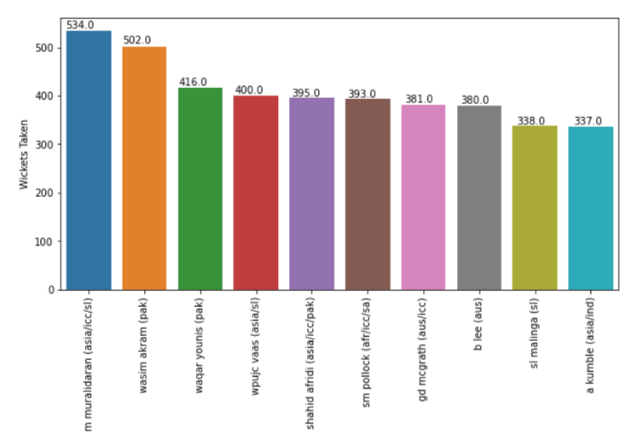
Methodology
Implemented using Python 3.9.0 and Anaconda 4.8.5 and libraries such as Matplotlib and Seaborn for visualization
3
Exploratory Data Analysis
The goal of exploratory data analysis is to investigate various aspects of cricket and identify the best performers in terms of batting and bowling.
The following visualization helps answer the question, “Who are the top ten bowlers with the highest number of wickets taken? ”

Slide 7
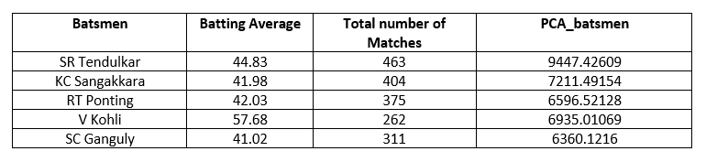
Methodology
Implemented using Python 3.9.0 and Anaconda 4.8.5 and libraries such as Matplotlib and Seaborn for visualization
3
Exploratory Data Analysis
The goal of exploratory data analysis is to investigate various aspects of cricket and identify the best performers in terms of batting and bowling.
The following visualization helps answer the question, “Based on the PCA formula to calculating batsmen performance, who are the top ten batsmen with the highest PCA score?”

Slide 8
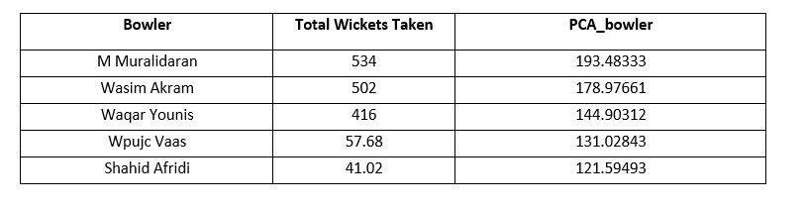
Methodology
Implemented using Python 3.9.0 and Anaconda 4.8.5 and libraries such as Matplotlib and Seaborn for visualization
3
Exploratory Data Analysis
The goal of exploratory data analysis is to investigate various aspects of cricket and identify the best performers in terms of batting and bowling.
The following visualization helps answer the question, “Based on the PCA formula to calculating bowlers performance, who are the top ten bowlers with the highest PCA score?”

Slide 9
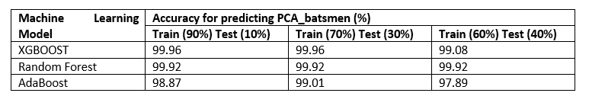
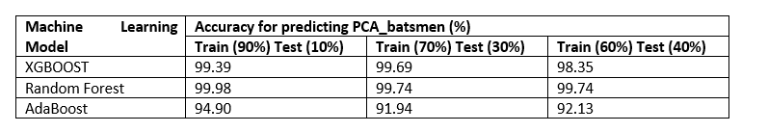
Model Implementation and Evaluation
Implemented using Python 3.9.0 and Anaconda 4.8.5
In this study, XGBOOST, ADABOOST, and Random Forest machine learning models are implemented to predict the PCA performance score for batsmen and bowlers. The dependent variable for all these models are the PCA performance score, whereas the independent variables are the performance metrics for batsmen and bowler.
Model Accuracy for Predicting Batsmen Performance
Model Accuracy for Predicting Bowlers Performance

Slide 10
Limitations and Future Work
The availability of additional characteristics in the data, such as weather, pitch conditions, ground, etc., can help identify better performance metrics.
The gameplay of cricket has changed over time, which may have an effect on a cricketer's performance attributes.
Incorporating additional factors could increase the detecting accurate characteristics affecting cricketers' performance.

Slide 11
Conclusion
This study is concluded by answering the proposed Research Question, "Which characteristics contribute to predicting the next great cricketer?"
Total number of runs scored by batsmen and bowlers during the game
The number of averages achieved by the batsmen and bowler
The number of strike rates achieved by the batsmen and bowler
During the game, a single bowler took the most wickets.
Total number of half centuries and centuries scored by the batsmen
Total number of fours and sixes scored by the batsmen
The bowler's economy rate throughout the game

